Slide 1
Putting On
Christ

Slide 2


Intro

Slide 3
Put on: Christ
Romans 13:11-14
Put on the armor of light, walk properly as in the day
Put on the Lord Jesus Christ
Galatians 3:26-29
For as many of you as were baptized into Christ have put on Christ.

Slide 4
Put on: Christ
Romans 6:3-6
  As many of us as were baptized into Christ Jesus were baptized into His death.
  We are buried with Him through baptism into death,
  As Christ was raised, we also should walk in newness of life.
  The old man was crucified with Him
  No longer slaves to sin
1 Peter 3:18-22
  being put to death in the flesh but made alive in the spirit,

Slide 5
Put on: The New Man
Ephesians 4:17-24
  Put off the old man
  Be renewed in the spirit of your mind
  Put on the new man
2 Peter 1:5-9
Add to your faith
  Goodness, Knowledge, Self-control, Perseverance
  Godliness, mutual affection, love

Slide 6
Put on: The New Man
Col 3:1-17
  Raised with Christ
  Seek things above
  Set minds on things above
  Put to death earthly things
  Put away: anger, wrath, malice, slander, and obscene talk from your mouth.
  Put on the new self
  Put on compassion, kindness, humility, meekness, and patience, forgiveness, love

Slide 7
Put on: Armor
Romans 13:12
  The night is far spent, the day is at hand. Therefore let us cast off the works of darkness, and let us put on the armor of light.
Eph 6:10-18
  V10. Put on the whole armor of God…
  14…having girded your waist with truth, having put on the breastplate of righteousness, 15 and having shod your feet with the preparation of the gospel of peace; 16 above all, taking the shield of faith with which you will be able to quench all the fiery darts of the wicked one. 17 And take the helmet of salvation, and the sword of the Spirit, which is the word of God; 18 praying always with all prayer and supplication in the Spirit, being watchful to this end with all perseverance and supplication for all the saints.

Slide 8

Put on: Armor - Belt/Waistband

Slide 9

Put on: Armor - Breastplate

Slide 10
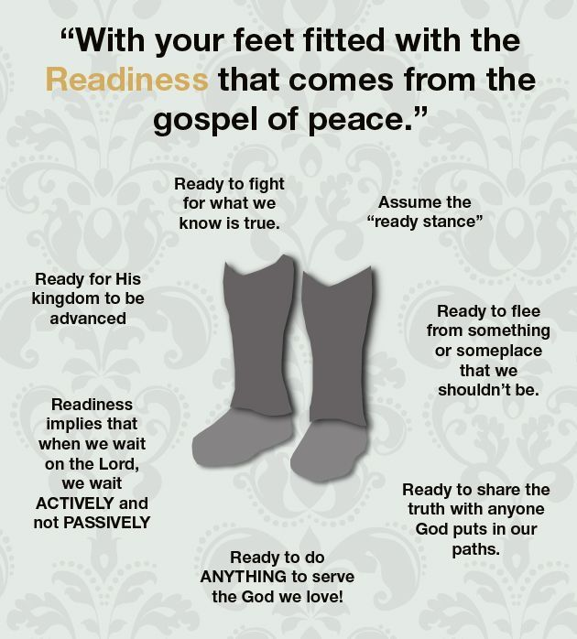
Put on: Armor - Feet Shod

Slide 11

Put on: Armor - Shield

Slide 12
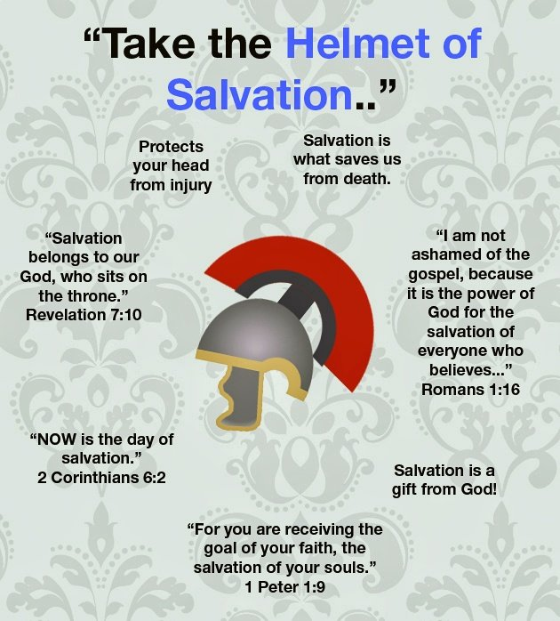
Put on: Armor - Helmet

Slide 13
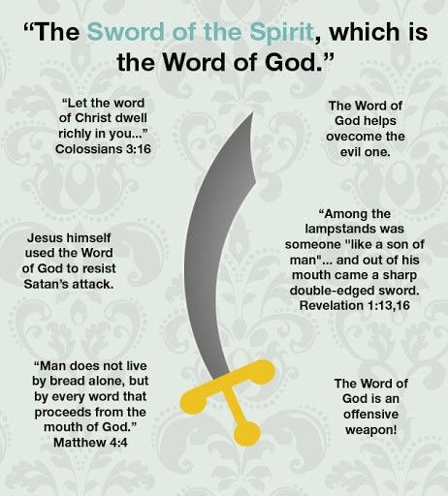
Put on: Armor - Sword

Slide 14
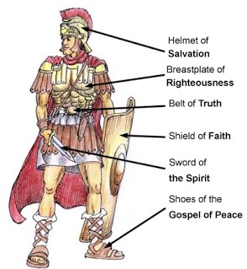
Put on: Armor - Whole

Slide 15

Put on:
Christ
New Man
Armor of God
James 1:21-25
  Lay aside all filthiness and wickedness
  Receive the word, which is able to save your souls
  Be doers of the word
  Look in the mirror

