Slide 1
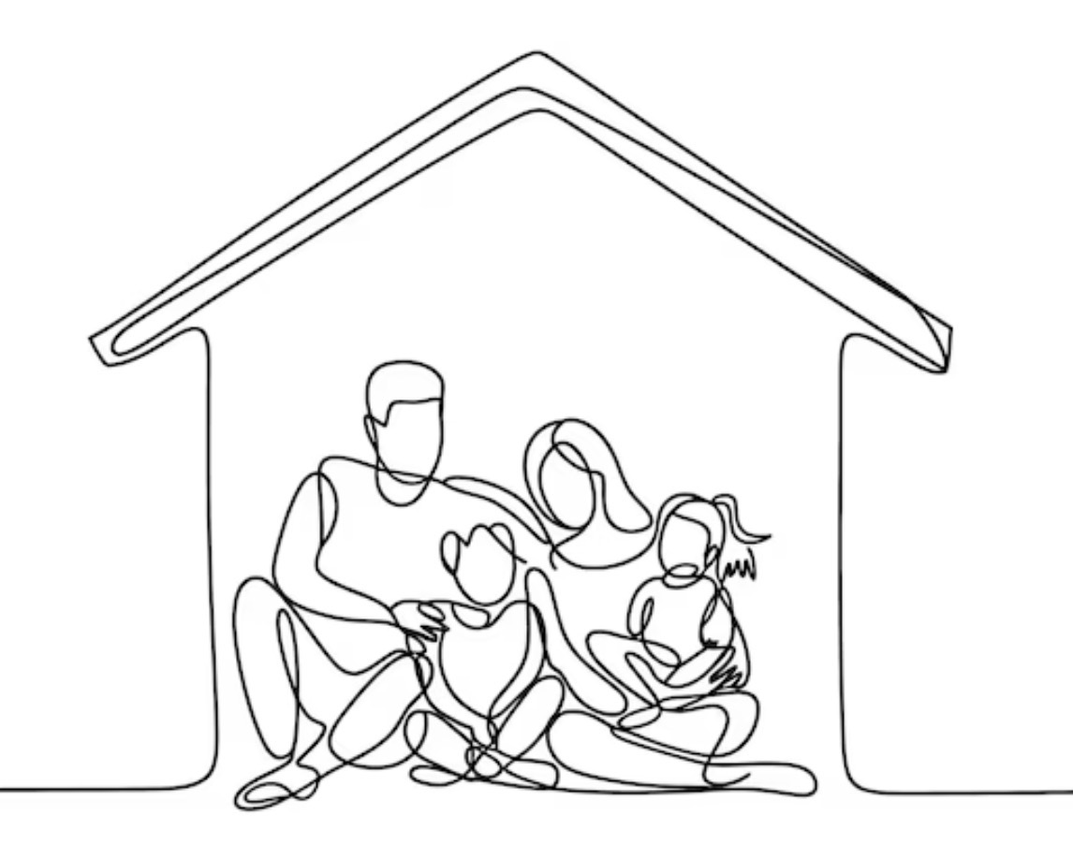
Households in Pattern

Slide 2
Households in Pattern
The Exile Instruction — Jer. 29:4-7
The Unit of Identity — Num. 1:1-4; Lev. 22:11-13
The Cultural Pressure is to Fragment — Acts 16:30-34; Eph. 2:19-22; 1 Tim. 3:4-5
Members of God’s House — Heb. 3:5-6; 2 Tim. 2:20-21
The Household Economy — 2 Cor. 9:10-15 (cf. Prov. 18:22; Eph. 6:1-2)
Breadth, Length, Height, and Depth
    Eph. 3:14-19; Ezk. 40-42; Rev. 11:2; 21:2-4, 9-11

Slide 3
Households in Pattern

